Slide 1


MAVEN
COFFEE
Coffee, Tea & Pastries
SALES
PERFORMANCE
REPORT
From January to June
Harold G. Catalla

Slide 2



OBJECTIVES
To check the sales trend from January to June
To know the product that drives the most revenue for the business
To identify the busiest day of the week

Slide 3


METHODOLOGY
Data cleaning, transformation and visualization using POWER BI

Slide 4
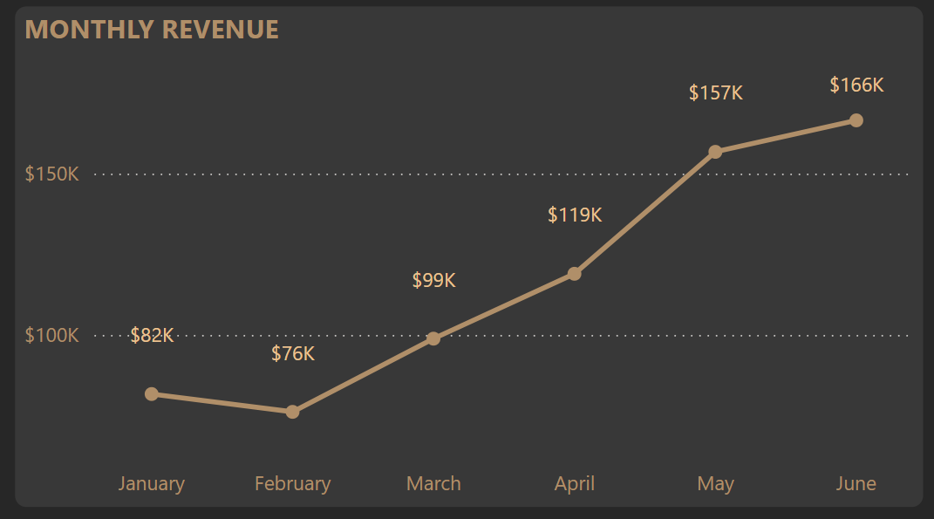
Sales Trend of Maven Coffee
From January to June
Since January, Maven Coffee sales rose by 50.94% or $84,808, reaching a total of $166,486 by June.
An upward trend of sales was observed from January to June.

Slide 5
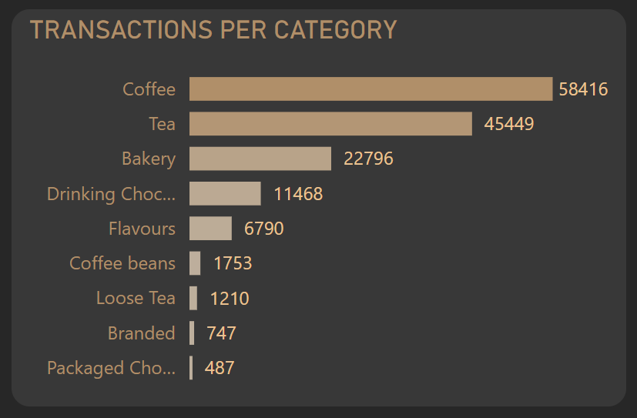
Biggest Contributors
The top three product categories with the highest transaction volumes are Coffee, Tea, and Bakery, while packaged chocolate is the lowest-selling category.
39.17% of transactions are from Coffee followed by Tea (30.48%) and Bakery (15.29%)

Slide 6
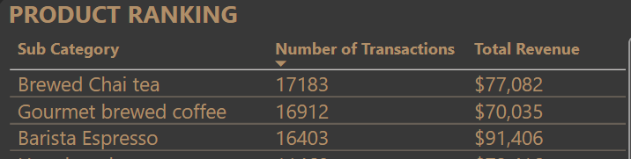
TOP 3 SELLING PRODUCTS
Brewed Chai Tea is the most transacted sub-category followed by Gourmet Brewed Coffee.
Barista Espresso has the highest total revenue contribution, exceeding Brewed Chai Tea by 18.58%, or $14,342.

Slide 7
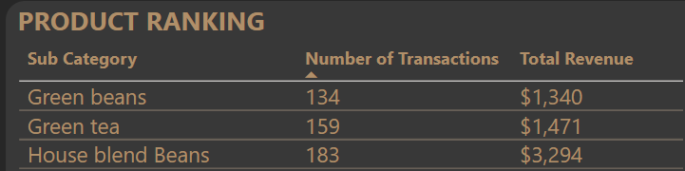
LEAST SELLING ITEM
The least selling product type is Green Beans followed by Green tea and House Blend beans.

Slide 8
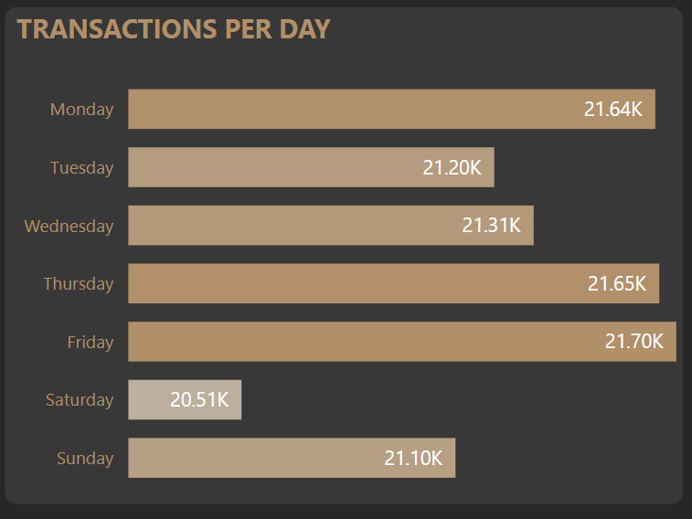
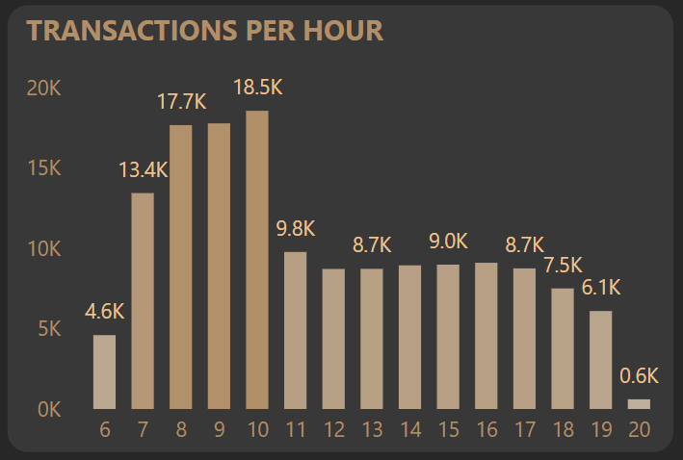
BUSIEST DAY OF THE WEEK
It was observed that the busiest days of the week are during Monday, Thursday and Friday.
While the store’s peak hours are between 8 a.m. and 10 a.m.

Slide 9

SUMMARY
An increase of 50.94% in sales was observed from January to June.
The least selling sub-category is Green Beans.
Coffee, Tea and Bakery are the most transacted product categories.
The busiest days are Monday, Thursday, and Friday, with peak hours from 8 a.m. to 10 a.m.
Although Brewed Chai Tea has the highest number of transactions, Barista Espresso contributes the most revenue.

Slide 10

RECOMMENDATIONS
Maximize the hours with most transactions
Use peak hours to introduce least selling products by giving samples to customers
Introduce Premium Versions of Brewed Chai Tea
Since Brewed Chai Tea has the highest transaction volume, offer a premium variant at a higher price to boost revenue.
Develop new flavor varieties for Top 3 Categories
Consider developing other variety or flavors of products under the Top 3 categories to maximize the sales

